Slide 1
The N400: How Math Informs Language
Erin Buchanan, Ph.D. Assistant Professor Psychology

Slide 2
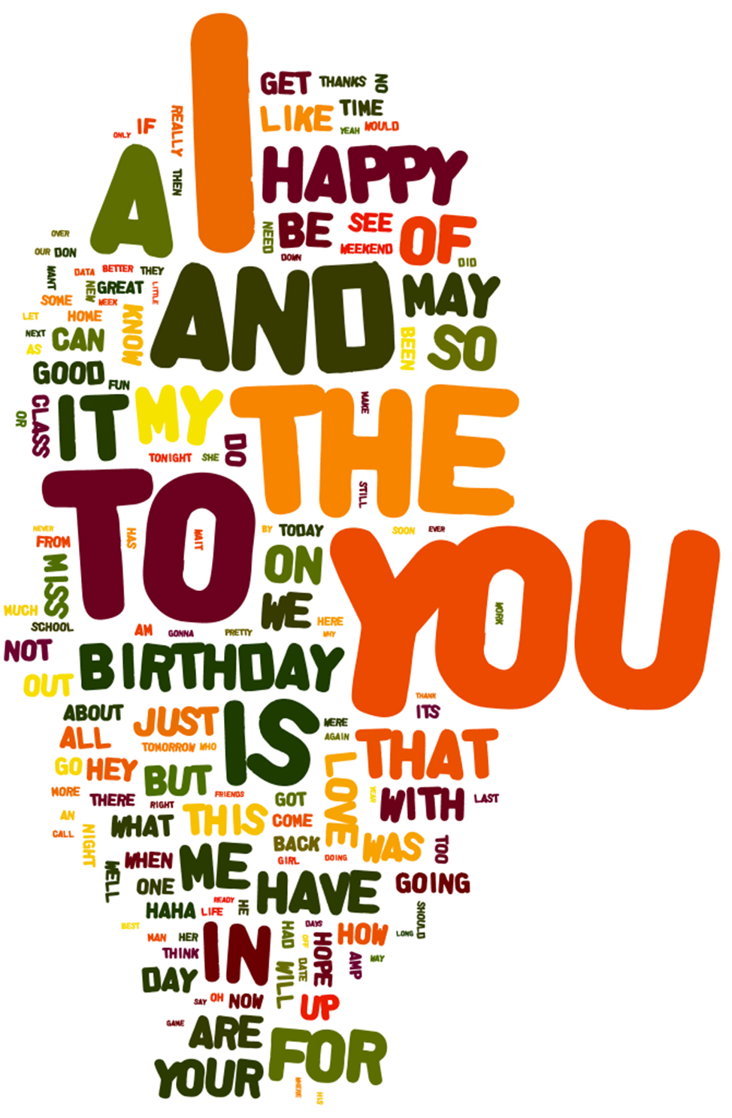
Language is…
Something we use
everyday
Frequency-Based
Context-Based
Meaning-Based

Slide 3
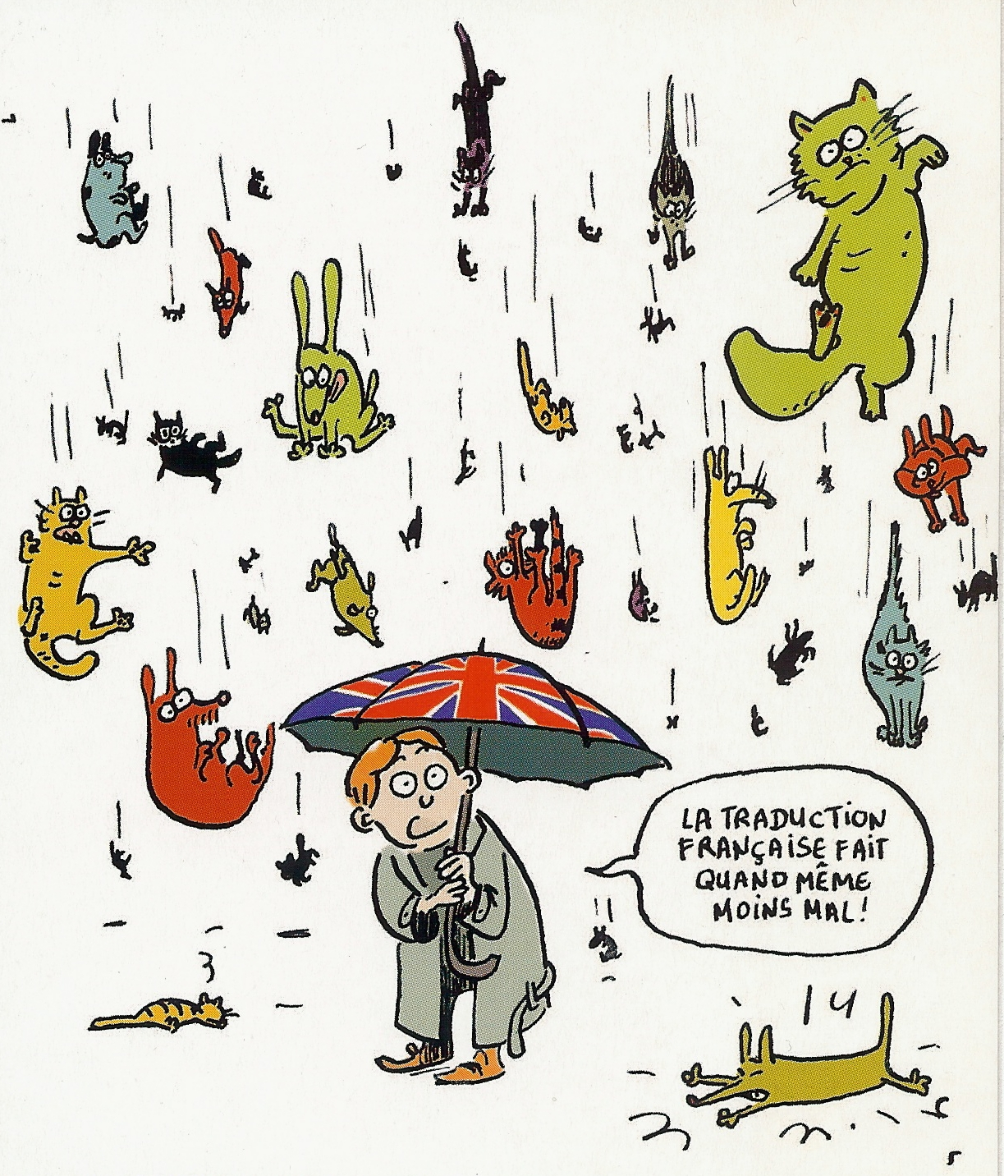

Language is…

Slide 4
Language is…
Semantic – dictionary based, features of words
Dogs have: tails, paws, noses, legs, etc.
Associative – context-based, frequency of use together
Peanut butter, rock & roll

Slide 5

Language measurement
Words, words, words!
Databases

Slide 6



Language measurement
Priming
=

Slide 7

Language measurement
EEG!
Using the brain to
understand language

Slide 8
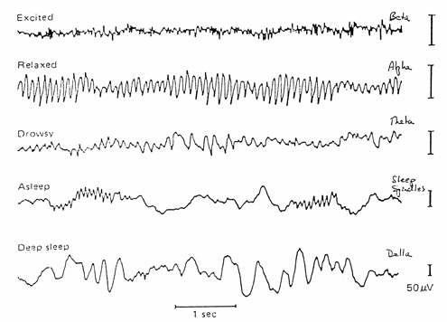
Language measurement

Slide 9
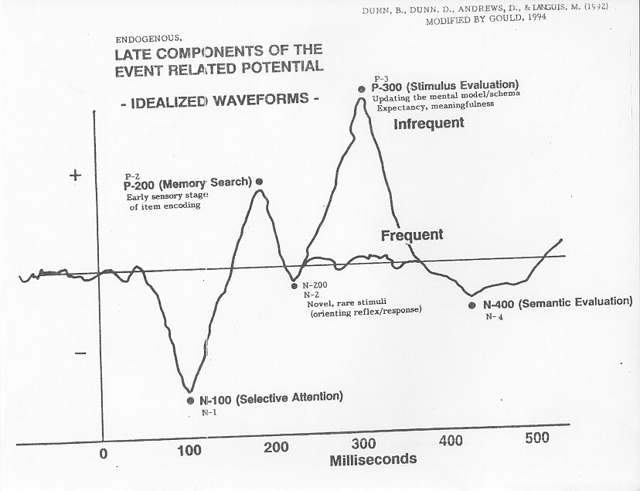
Language measurement

Slide 10
Method
Participants:
13 females
7 males
Recruited from upper level psychology classes.

Slide 11

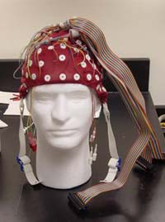
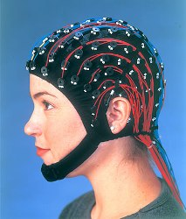
Method
We hooked up the brainz!

Slide 12
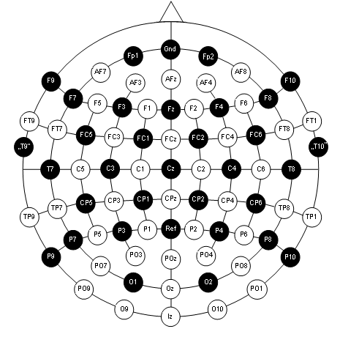

Slide 13
Method
Tasks:
Lexical Decision – is this a word?
Letter Search – does this word have double letters?
Notes:
360 trials:
60 Associated
60 Semantic
120 Unrelated
120 Nonw0rds
Talk about where words came from

Slide 14
Tasks
NURSE

Slide 15
Tasks
WERM

Slide 16
Tasks
DOCTOR

Slide 17

Tasks

Slide 18
Data Processing
Filtering:
Taking out the natural movement (Independent Components Analysis)
Taking out the bad movements (by hand)

Slide 19
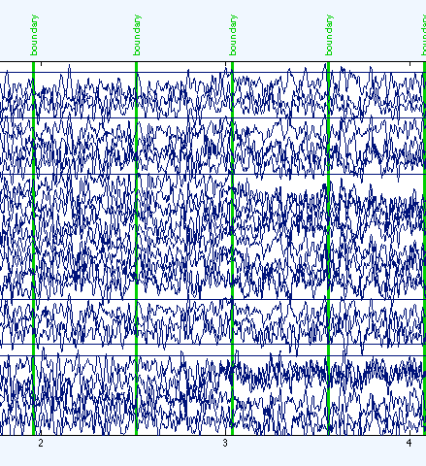
Bad Data
Bad data is caused by machine problems, extreme movement, or electric interference.

Slide 20
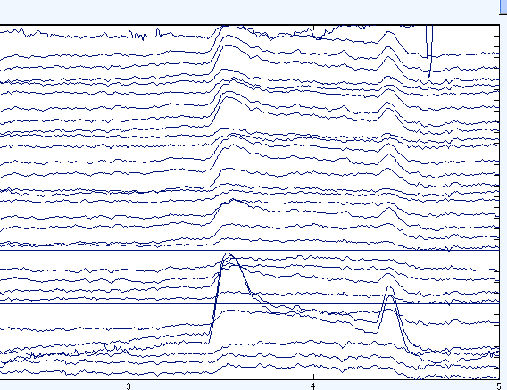
Good Data!
All EEG data naturally has spikes – they are caused by blinking and moving.

Slide 21
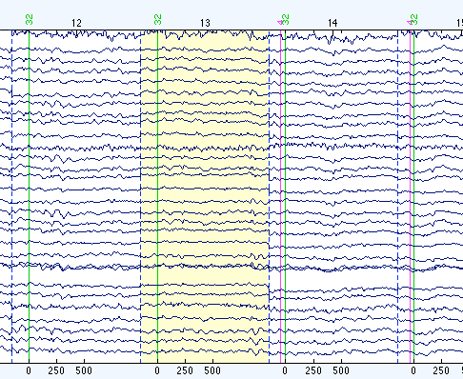
Filtered Good Data
Eye blinks and other movement artifact are removed with a ICA program.

Slide 22
Data Processing
Filtering:
Taking out the natural movement (Independent Components Analysis)
Taking out the bad movements (by hand)
Referencing:
Adjusting the EEG data based on mastoid bones
Adjusting event trials based on previous 150 msecs

Slide 23
Data Analysis
So after torturing the data, what do we have?
Data matrix: Channel X Stimulus X Task
Channels: PZ, FZ, FCZ, CZ, and PCZ
Stimulus: Non-word, Unrelated, Associative, Semantic
Task: Lexical Decision and Letter Search

Slide 24
Data Analysis Types

Slide 25
Data Analysis Types

Slide 26
Data Analysis Types

Slide 27
Data Analysis Types

Slide 28
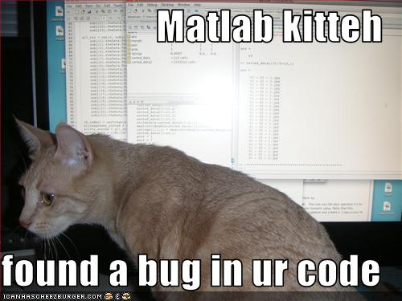
Data Analysis
Area under the curve was calculated using MATLab trapz function
Statistical analyses were done with SPSS.

Slide 29

Results

Slide 30
Results
Lexical Decision Task Hypotheses:
Non-words would be more negative
Semantic words would be more positive
Associative words would be more positive
All compared to Unrelated with t-tests

Slide 31
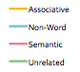
Results
CZ
CPZ

Slide 32
Results
Letter Search Task Hypotheses:
Non-words would not be different
Semantic words would be positive *
Associative words would be positive*
Compared to unrelated words with t-tests
*if priming is automatic

Slide 33
Results
PZ
FZ

Slide 34
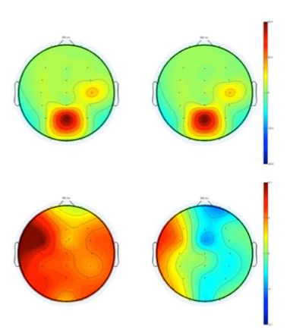
Results

Slide 35
Results
Reaction time hypotheses:
Non-words would be slower
Semantics words would be faster*
Associative words would be faster
Compared to unrelated words with t-tests
*task dependent

Slide 36
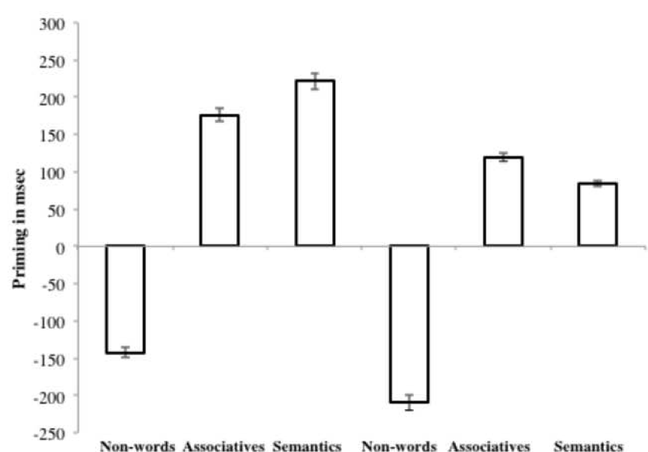
Results

Slide 37

Discussion

Slide 38
Discussion
In psychology-ese:
Words show the same N400 patterns in priming tasks when studied precisely
Argues for automaticity of activation because letter search shouldn’t use word information
Supports similar cognitive architecture for related word types

Slide 39
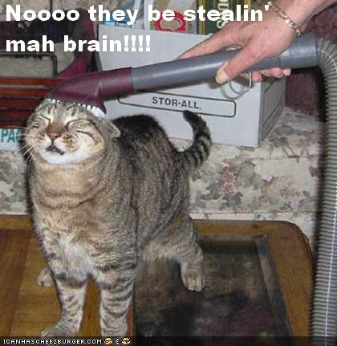
Discussion
Questions?

